Slide 1

Your Bitcoins, Safe and Easy
Solutions for High-Net-Worth Individuals and Institutional Investors
November 4, 2021
Michele Mandelli / Managing Partner
michele@checksig.io
All rights reserved. The information contained in this document is confidential. Without prior written approval, no part of this document may be reproduced or transmitted in any form or by any means, including but not limited to electronic, mechanical, photocopying or recording or stored in any retrieval system of whatever nature.
Notes:
I’m the last obstacle between you and a very deserved coffee break, so I promise I’ll be brief.

Slide 2
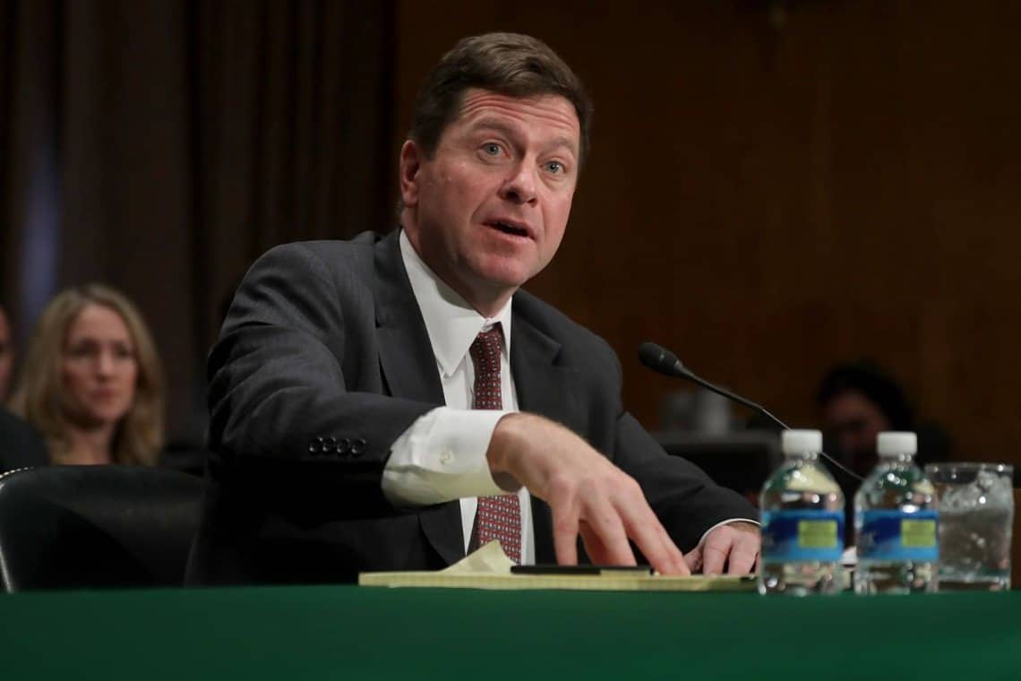


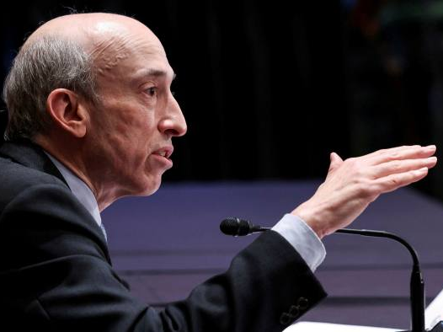
How it started…
“Bitcoin is a fraud”
Jamie Dimon, 2017
“Warning to cryptocurrency investors”
Jay Clayton, 2017
“Bitcoin is not a real currency”
Jerome Powell, 2018
Notes:
We have all witnessed bitcoin and digital assets shift from a derision, skepticism and dark web narrative…

Slide 3


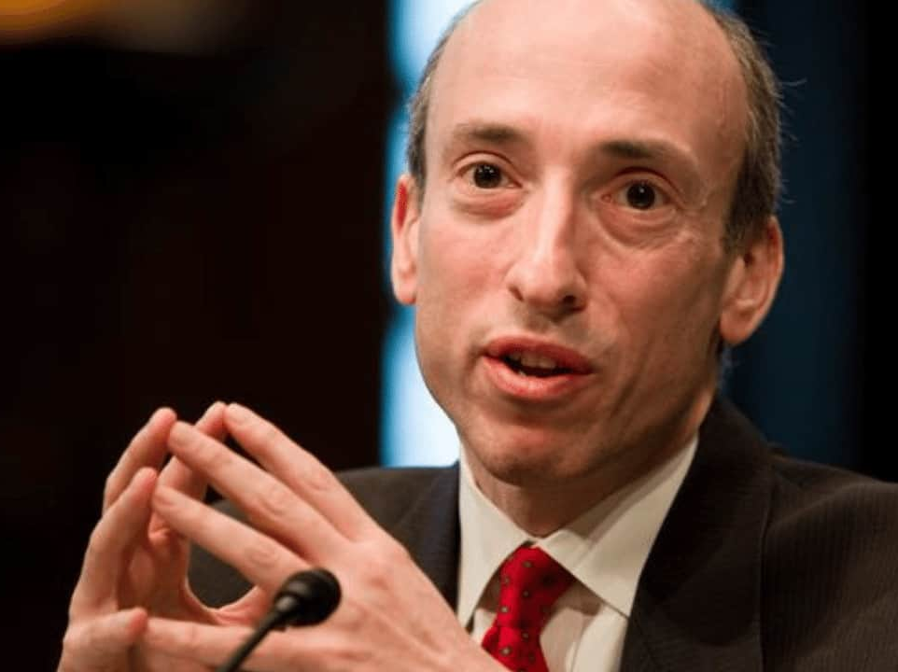
…how it’s going
“Our clients are adults. We can give them access”
Jamie Dimon, 2021
“No plan to ban crypto”
Gary Gensler, 2021
“Fed had no intention to ban or limit the use of cryptocurrencies”
Jerome Powell, 2021
Notes:
…to an investable asset

Slide 4

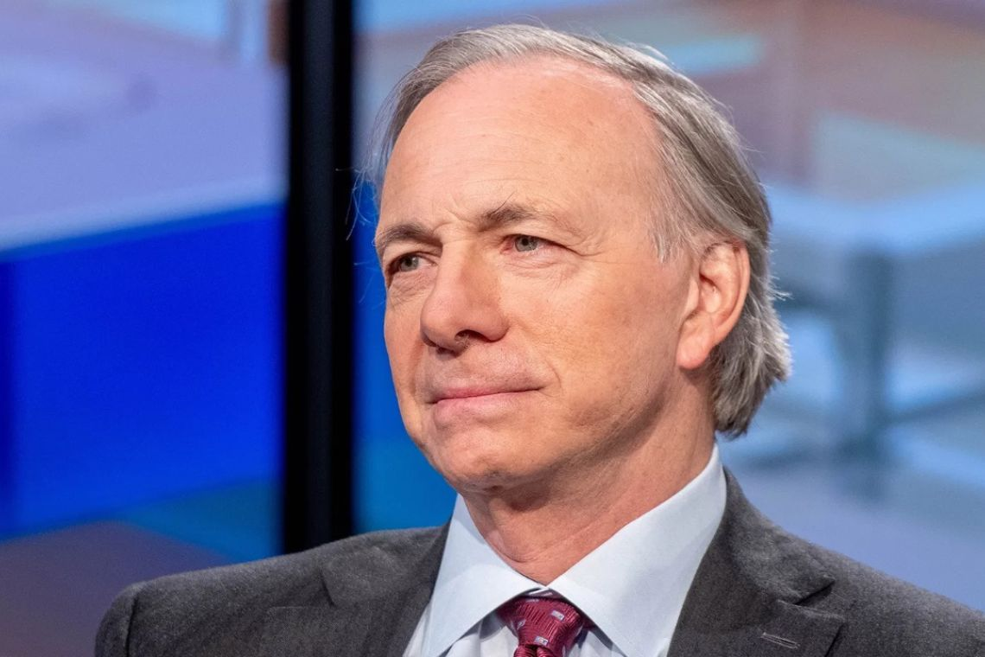






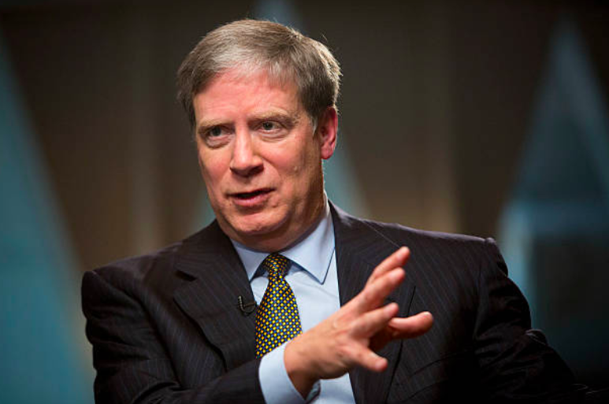






Bitcoin is now sought after by the most sophisticated investors
Affluent and HNW Individuals
Institutional Investors
Corporate trasuries
Futures and options
Paul Tudor Jones
Ray Dalio
And hundreds more…
Tier 1 banks
ETF/ETP providers
Stanley Druckenmiller
Notes:
Which is sought after by HNWI and institutions. What we are witnessing right now is the rise of a brand new financial services business, which was unthinkable just a few year ago

Slide 5



Challenges for Bitcoin investors
Simplicity
Bitcoin exchanging is still a far west: even for educated traditional investors it’s not so easy to tell apart reputable platforms
Onboarding and funding processes are complex and cumbersome, and trading interfaces not so intuitive
Simpler interfaces (e.g. fast lanes, market buys) are very expensive
Most solutions are focused on self-service, while first time HNW investors seek advisory/assistance
Typical entry ticket of affluent clients is “psicologically significant” but still too small to get OTC desks’ attention
Security
Bitcoin is a “bearer instrument” and it can only be spent by using secret (private) keys
Losing the secret keys means losing the associated Bitcoins: no one can recover them
Secret keys are usually stored in ”wallets”; however
Hot (online) wallets can be hacked
Cold (offline) wallets can be lost or stolen
Passwords can be forgotten
Inheritance problem: how do heirs acquire the secret keys?
Personal safety problems: coercion, violence, ransom, etc.
Traditional cyber security is not a good fit for Bitcoin storage
Compliance
Many exchanges –even the most reputable- don’t provide an easy and strong audit trail to prove origin of funds and gains/losses
Tax laws are in the making, and most tax advisors have little to no experience in crypto
Buying Bitcoins, especially for significant amounts, is still a high friction experience
Dealing with Bitcoins requires sophisticated technical skills and domain knowledge
Complying with the law is often cumbersome and impractical even for best intentioned investors
Notes:
But especially for HNWI and Institutinals, there are still significant challenges to a wider adoption – or investment in this case

Slide 6














A “bank-like” bitcoin solution for Affluent Individuals and Institutions
Learning
News, podcasts and reports,
seminars and workshops
from the Digital Gold Institute
Brokerage
Multi-exchange buy and sell order execution
Custody
Top-notch security with the world’s safest protocol
Crypto dossier
Integrated data collection
for easy tax reporting
Inheritance
Wealth planning and heirs’ support
Services
Multi-country
Legal framework arbitrage
Loans
Escrow for collateralized loans
CH Q1’22, UK&DE Q2’22
1:1 assistance
Dedicated customer contact
Joint ownership
Delegates and multi-user
Q1 ‘22
Facilities
Insured funds
Covered withdrawals
SOC 1 & 2
Attestations from Deloitte
Multi-sig, multi-level
Frozen custody protocol
Proof-of-Reserves
Cryptographic proof
Enablers
= Only crypto company in Italy / the world
Notes:
This is why we founded CheckSig, A “bank-like” bitcoin solution for Affluent Individuals and Institutions.
CheckSig is in many ways unique: it’s the only Italian crytpo company with insured funds and SOC attestations.
It provides 1:1 assistance and very flexible account solutions.
But at the heart of it all, CheckSig’s foundation is the world’s most secure custody protocol.

Slide 7
Multi-sig, multi-level custody setup
Client
Insurance guarantees
Disconnected from the internet as defense from remote hacks, CheckSig custody solution has two levels of storage: the “cold” and “frozen” wallets
Clients deposit to the frozen level. The frozen level, where all assets are securely stored, is managed by multiple external and independent legal entities, the federation agents. Each entity has a customized (locked-down) hardware security module (HSM) device that can open the vault (i.e., move coins) only if:
authorized by CheckSig
3-of-5 legal entities approve it
coins go to the cold wallet and/or back to the frozen one
The cold storage is empty, but for the amount being withdrawn and covered by insurance guarantees. CheckSig manages the cold wallet. It can move coins only if 2-of-3 CheckSig agents sign the transaction, usually moving coins to:
a client, upon a withdrawal request
back to the frozen wallet (if, for whatever reason, the withdrawal is cancelled)
Withdraw and/or redeposit
CheckSig
Deposit
Cold Wallet
(2-of-3 multi-sig)
Authorized by CheckSig (2-of-3 multi-sig)
Proof-of-reserves
Unlock and redeposit to whitelisted addresses
Federation
Frozen Wallet
(3-of-5 multi-sig)
PUBLIC PROTOCOL
See checksig.io/custody-protocol
Notes:
Because of the way it is designed, CheckSig’s protocol allows for full onchain auditability and tis –crucially- allows for a public Proof of Reserve

Slide 8
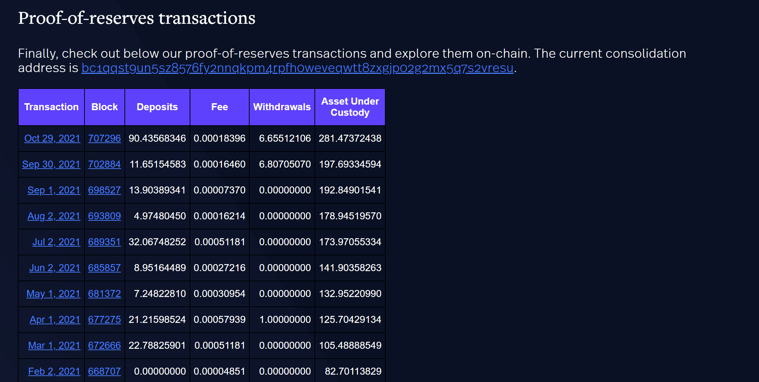
Proof of Reserve
LIVE at checksig.io/por

Slide 9
Provably Solvent
PoR
Proof of Reserve
PoL
Proof of Liabilities
PoS
Proof of Solvency
Cryptographic
Through
External Audits

Slide 10

CheckSig a new standard for transparent bitcoin custody
A non-profit community to remove patents as a barrier to growth and innovation:
COPA members pledge never to use their crypto-technology patents against anyone, except for defensive reasons, effectively making their patents freely available for all to use
members pool all of their crypto-technology patents together to form a shared patent library
Is a proud member of the
Along with Coinbase, Kraken, Blockstream and many others
Notes:
Having an awesome solution is not enough. We want this solution to become a new standard for transparent bitcoin custody, and push the boundaries for innovation and investor protection.
We hope this

Slide 11
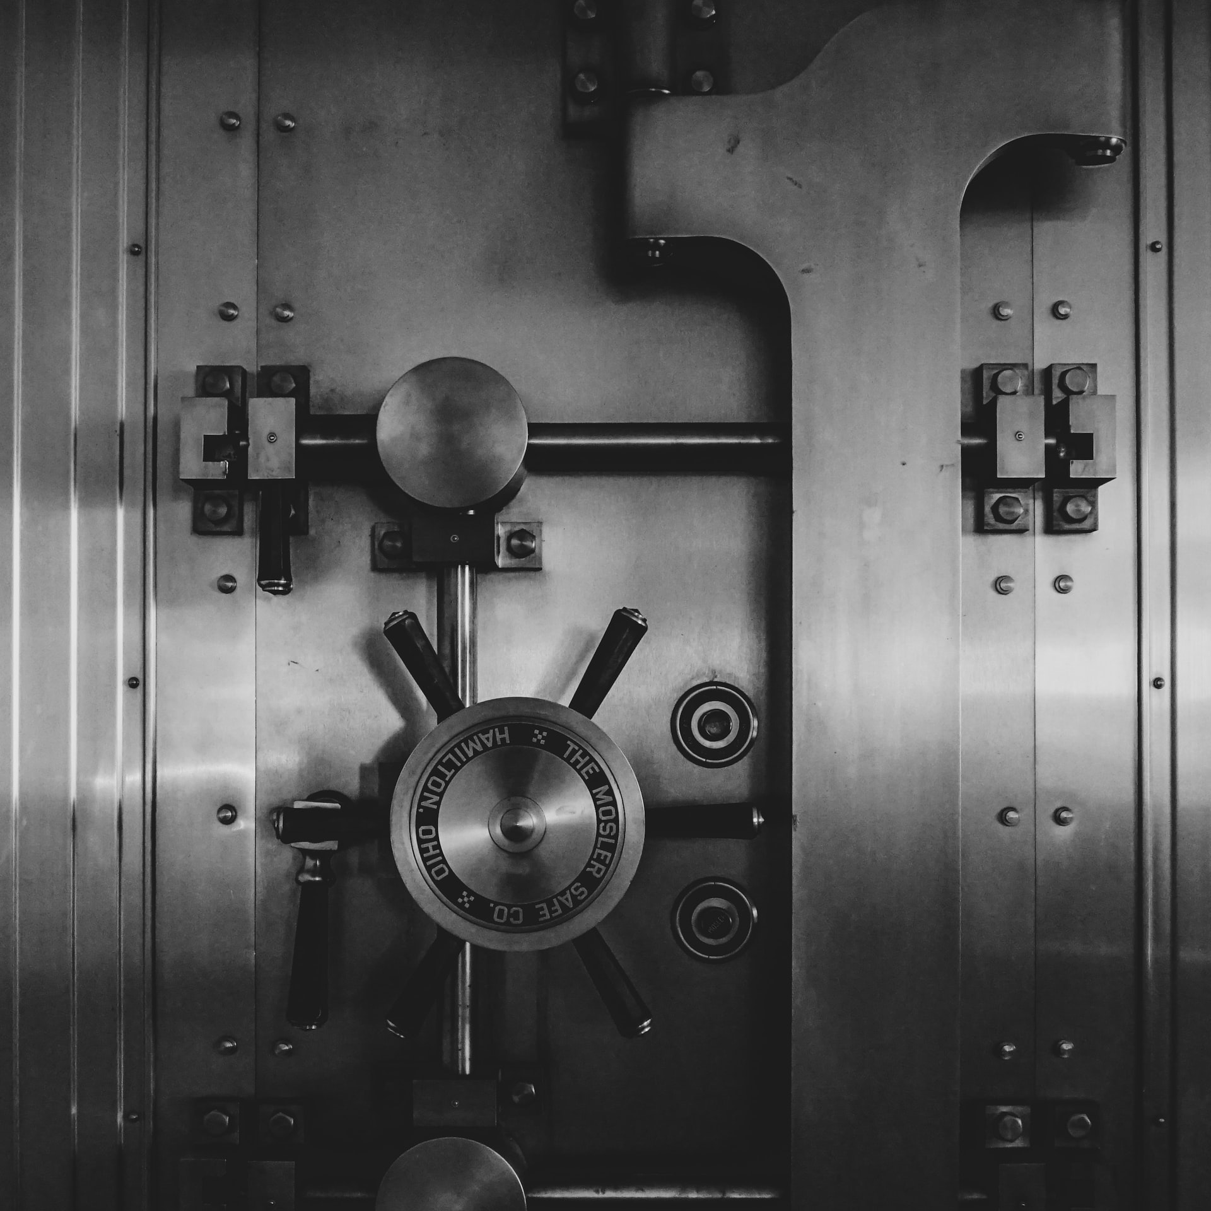
Thank you!
Michele Mandelli / Managing Partner
michele@checksig.io

